Slide 1
Classification Model
Classification: Basic Concepts
Rule-Based Classification
Decision Tree Induction
Bayes Classification Methods
kNN Classifier
Performance Evaluation
Ensemble Classification
Summary
1
Notes:
1

Slide 2
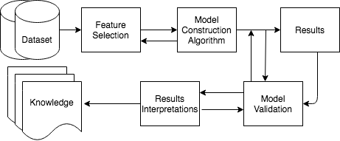
Basic Steps of Data Analysis
Notes:
2

Slide 3
Decision Tree Model

Slide 4
Decision Tree
In principle, there are exponentially many decision trees that can be constructed from a given set of attributes.
Finding the optimal tree (in terms of performance) is computationally infeasible because of the exponential size of the search space.
Efficient algorithms have been developed to induce a reasonably accurate although suboptimal decision tree in a reasonable amount of time.
These algorithms usually employ a greedy strategy that grows a decision tree by making a series of locally optimum decision about which attribute to use for partitioning the data.
One such algorithm is Hunt’s algorithm, which is the basis of many decision tree induction algorithms, including ID3, C4.5, and CART.

Slide 5
Hunt’s Algorithm
In this algorithm, a decision tree is grown in a recursive fashion by partitioning the training records into successively purer subsets.
Let D_{t} be the set of training records that are associated with node t and y={y₁, y₂, …, y_{c}} be the class labels. The following is a recursive definition of Hunt’s algorithm:
Step 1: If all the records in D_{t} belong to the same class y_{t}, then t is a leaf node labelled as y_{t}.
Step 2: If D_{t} contains records that belong to more than one class, an attribute test condition is selected to partition the records into smaller subsets. A child node is created for each outcome of the test condition and the records in D_{t} are distributed to the children based on the outcomes.
The algorithm is then recursively applied to each child node.

Slide 6
Decision Tree Induction: ID3
Training data set: Buys_computer
Decision tree model is constructed using the Quinlan ID3 algorithm.
ID3 refers to Iterative Dichotomizer 3, and is developed by Ross Quinlan
It iteratively dichotomizes (divides) the data using a top down greedy approach.
The algorithm optimizes locally at each iteration.

Slide 7
Decision Tree Induction: ID3
Root is identified first, then the parents of next label, and so on of the decision tree are identified using entropy theory based optimization function
Resulting tree:
age?
<=30
31..40
>40
student?
yes
credit rating?
no
yes
excellent
fair
no
yes
no
yes

Slide 8
Algorithm of ID3
Basic algorithm (a greedy algorithm)
Tree is constructed in a top-down recursive divide-and-conquer manner
At start, all the training examples are at the root
Attributes are categorical (if continuous-valued, they are discretized in advance)
Examples are partitioned recursively based on selected attributes
Test attributes are selected on the basis of a heuristic or statistical measure (e.g., information gain)
Conditions for stopping partitioning
All samples for a given node belong to the same class
There are no remaining attributes for further partitioning – majority voting is employed for classifying the leaf
There are no samples left

Slide 9
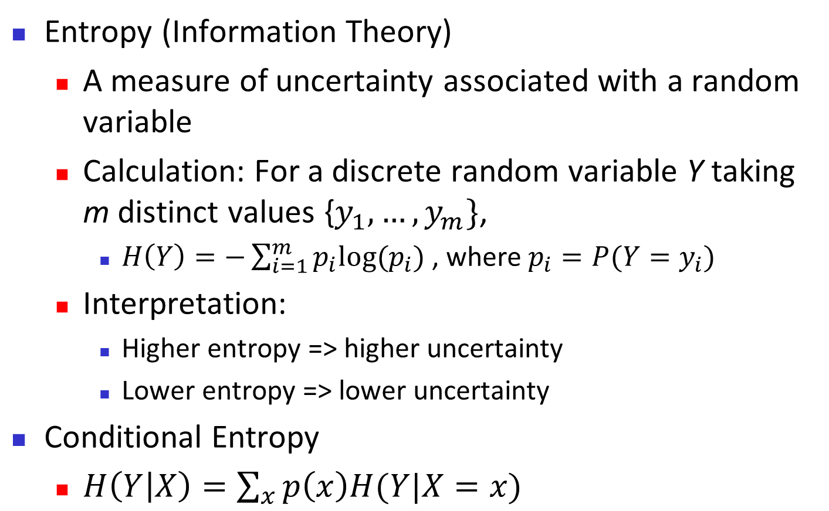
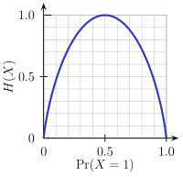
Brief Review of Entropy (Already discussed in entropy based discretization technique)
Y/(X=x1) Y/(X=x2) ………. Y/(X=x) Y/( X=x_{n})
m = 2

Slide 10
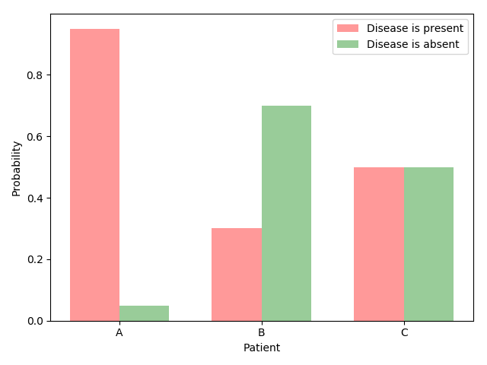
Entropy and uncertainty
Suppose three patients have completed a medical test which, yields one of two possible results: the disease is either present or absent.
Let Patient A has 95% chance that he has the disease. For Patient B and C it is 30% and 50%, respectively.
So, if A, B, and C are in waiting room of a doctor’s office, then the uncertainty of the waiting room is:

Slide 11
Entropy and uncertainty
All other things being equal, which of the three patients is confronted with the greatest degree of uncertainty?
I think the answer is clear: patient C.
Compare this with patient A. Patient A is experiencing little uncertainty with regard to his medical prospects.
Intuitively speaking, uncertainty of patient B falls in between that of A and C.
Measuring uncertainty: Entropy is a measure of uncertainty.
Entropy allows us to make precise statements and perform computations with regard to one of life’s most pressing issues: not knowing how things will turn out.
By the term entropy, I will refer to Shannon entropy, which is used most frequently in natural language processing and machine learning.

Slide 12
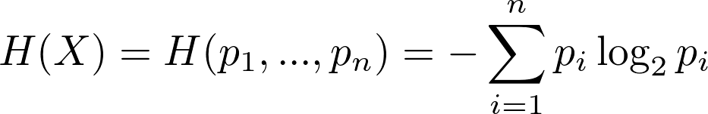
Entropy and uncertainty
The Shannon entropy formula for an event X with n possible outcomes and probabilities p₁, …, p_{n}:
Basic properties of uncertainty:
Prop. 1: Uniform distributions have maximum uncertainty
If your goal is to minimize uncertainty, stay away from uniform probability distributions.

Slide 13
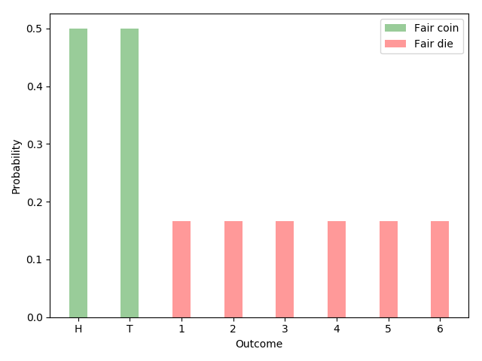
Prop -1 of uncertainty
A probability distribution is a function that assigns a probability to every possible outcome such that the probabilities add up to 1.
A distribution is uniform when all of the outcomes have the same probability.
For example, fair coins (50% heads, 50% tails) and fair dice (1/6 probability for each of the six faces) follow uniform distributions.

Slide 14
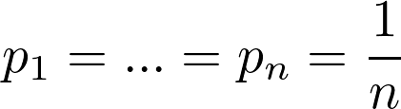
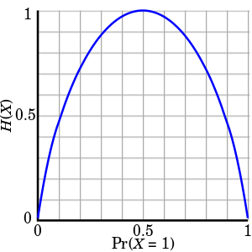
Prop -1 of uncertainty
A good measure of uncertainty achieves its highest values for uniform distributions.
Entropy satisfies the criterion. Given n possible outcomes, maximum entropy is maximized by equiprobable outcomes:
Here is the plot of the Entropy function as applied to Bernoulli trials (events with two possible outcomes and probabilities p and 1-p):
In the case of Bernoulli trials,
entropy reaches its
maximum value for p=0.5

Slide 15
Prop -2 of uncertainty
Prop-2: Uncertainty is additive for independent events
Let A and B be independent events. In other words, knowing the outcome of event A does not tell us anything about the outcome of event B.
The uncertainty associated with both events should be the sum of the individual uncertainties:
Let’s use the example of flipping two coins to make this more concrete. We can either flip both coins simultaneously or first flip one coin and then flip the other one.
In other words, we can either report the outcome of the two coin flips at once or separately. The uncertainty is the same in either case.

Slide 16
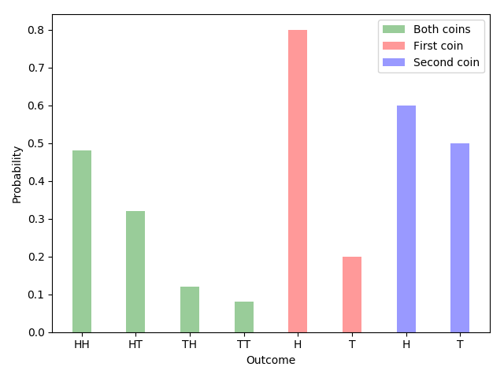
Prop -2 of uncertainty
Ex: Let the first coin lands heads (H) up with an 80% probability and tails (T) up with a probability of 20%.
The probabilities for the other coin are 60% and 40%.
If we flip both coins simultaneously, there are four possible outcomes: HH, HT, TH and TT. The corresponding probabilities are given by [ 0.48, 0.32, 0.12, 0.08 ].
The joint entropy (green) for the two independent events is equal to the sum of the individual events (red and blue).

Slide 17
Prop -2 of uncertainty
Plugging the numbers into the entropy formula, we see that: Just as promised,

Slide 18
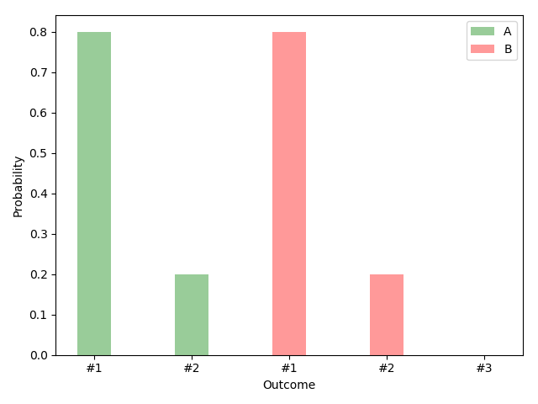
Prop -3 of uncertainty
Prop-3: Adding an outcome with zero probability has no effect
Suppose (a) you win whenever outcome #1 occurs and (b) you can choose between two probability distributions, A and B.
Distribution A has two outcomes: say, 80% and 20%. Distribution B has three outcomes with probabilities 80%, 20% and 0%.

Slide 19
Prop -3 of uncertainty
Given the options A and B, which one would you choose?
Ans: The inclusion of the third outcome neither increases nor decreases the uncertainty associated with the game. A or B, who cares. It doesn’t matter.
The entropy formula agrees with this assessment:
In words, adding an outcome with zero probability has no effect on the measurement of uncertainty.

Slide 20
Prop -4 of uncertainty
Prop-4: The measure of uncertainty is continuous in all its arguments
The last of the basic properties is continuity.
Famously, the intuitive explanation of a continuous function is that arbitrarily small changes in the output (uncertainty, in our case) should be achievable through sufficiently small changes in the input (probabilities).
Logarithm functions are continuous at every point for which they are defined. So are sums and products of a finite number of functions that are continuous on a subset.
It follows that the entropy function is continuous in its probability arguments.

Slide 21
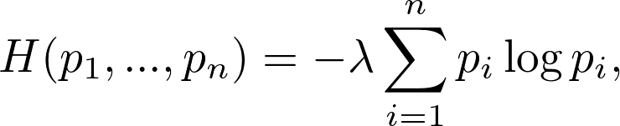
Entropy
The Uniqueness Theorem: Khinchin (1957) showed that the only family of functions satisfying the four basic properties described above is of the following form:
where λ is a positive constant. Khinchin referred to this as the Uniqueness Theorem.
Setting λ = 1 and using the binary logarithm gives us the Shannon entropy.
To reiterate, entropy is used because it has desirable properties and is the natural choice among the family functions that satisfy all items on the basic properties.

Slide 22
Entropy
Other properties of Entropy:
Entropy has many other properties used in Khinchin’s Uniqueness Theorem. Some of them:
Prop-5: Uniform distributions with more outcomes have more uncertainty
Suppose you have the choice between a fair coin and a fair die:
Fair coin or fair die ?

Slide 23

Entropy
And let’s say you win if the coin lands heads up or the die lands on face 1.
Which of the two options would you choose?
(i) if you are a profit maximizer and
(ii) if you prefer with more variety and uncertainty.
As the number of equiprobable outcomes increases, so should our measure of uncertainty.
And this is exactly what Entropy does: H(1/6, 1/6, 1/6, 1/6, 1/6, 1/6) > H(0.5, 0.5).
And, in general, if we let L(k) be the entropy of a uniform distribution with k possible outcomes,
for m> n

Slide 24
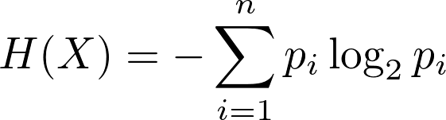
Entropy
Prop-6: Events have non-negative uncertainty
Do you know what negative uncertainty is? Neither do I.
A user-friendly measure of uncertainty should always return a non-negative quantity, no matter what the input is.
This is yet another criterion that is satisfied by entropy. Let’s take another look at the formula:
Probabilities are, by definition,
in the range between 0 and 1 and, therefore, non-negative.
The logarithm of a probability is non-positive. Multiplying the logarithm of a probability with a probability doesn’t change the sign. The sum of non-positive products is non-positive. And finally, the negative of a non-positive value is non-negative.
Entropy is, thus, non-negative for every possible input.

Slide 25
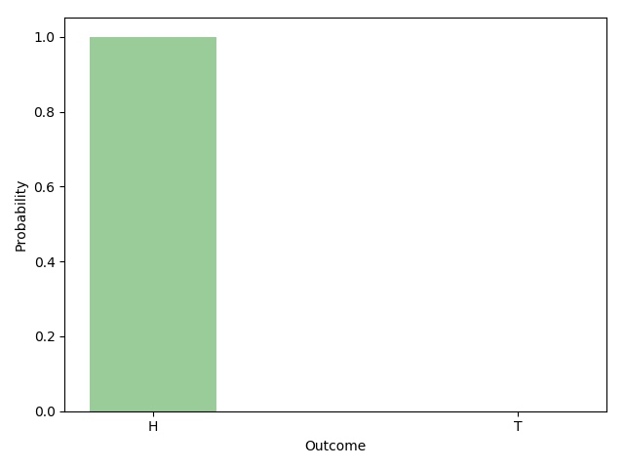
Entropy
Prop-7: Events with a certain outcome have zero uncertainty
Suppose you are in possession of a magical coin. No matter how you flip the coin, it always lands head up.
Suppose that outcome i certain to occur. It follows that pi, the probability of outcome i, is equal to 1. H(X), thus, simplifies to:

Slide 26
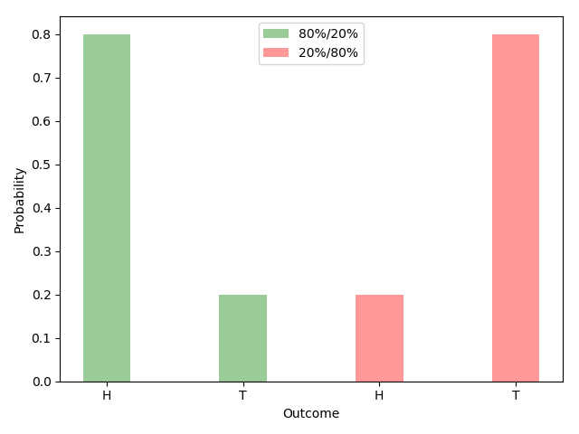
Entropy
Prop-8: Flipping the arguments has no effect
This is another obviously desirable property. Consider two cases. In the first case, the probability of heads and tails are 80% and 20%. In the second case, the probabilities are reversed: heads 20%, tails 80%.

Slide 27

Entropy
Both coin flips are equally uncertain and have the same entropy: H(0.8, 0.2) = H(0.2, 0.8).
In more general terms, for the case of two outcomes, we have:
This fact applies to any number of outcomes. We can position the arguments (i.e., the probabilities of a distribution) in any order we like. The result of the entropy function is always the same.

Slide 28
Attribute Selection Measure: Information Gain (ID3/C4.5)
Select the attribute with the highest information gain
Let p_{i} be the probability that an arbitrary tuple in D belongs to class C_{i} , estimated by |C_{i, D}|/|D|
Expected information (entropy) needed to classify a tuple in D:
Information needed (after using A to split D into v partitions) to classify a tuple in D:
Information gained by branching on attribute A
Notes:
I : the expected information needed to classify a given sample
E (entropy) : expected information based on the partitioning into subsets by A

Slide 29
Attribute Selection: Information Gain
Class P: buys_computer = “yes”
Class N: buys_computer = “no”
means “age <=30” has 5 out of 14 samples, with 2 yes’es and 3 no’s. Hence
Similarly,

Slide 30
Computing Information-Gain for Continuous-Valued Attributes
Let attribute A be a continuous-valued attribute
Must determine the best split point for A
Sort the value A in increasing order
Typically, the midpoint between each pair of adjacent values is considered as a possible split point
(a_{i}+a_{i+1})/2 is the midpoint between the values of a_{i} and a_{i+1}
The point with the minimum expected information requirement for A is selected as the split-point for A
Split:
D1 is the set of tuples in D satisfying A ≤ split-point, and D2 is the set of tuples in D satisfying A > split-point

Slide 31
Gain Ratio
Gain Ratio is an improved version of Information Gain,
In decision trees, it helps mitigate a bias that Information Gain has towards attributes with many values.
Gain Ratio is often better:
1. Bias in Information Gain
Information Gain measures how much uncertainty (entropy) is reduced when splitting the data based on a particular attribute.
However, it tends to favor attributes with a large number of distinct values (e.g., unique IDs, timestamps), even if they are not meaningful for classification.

Slide 32
Gain Ratio
2. Gain Ratio Normalization
Gain Ratio adjusts Information Gain by dividing it by the Split Information, which represents how broadly the data is split.
GainRatio(A) = Gain(A)/SplitInfo(A)

Slide 33
Gain Ratio
3. Effect of Gain Ratio
By penalizing splits that create many small partitions (high Split Information), Gain Ratio avoids favoring attributes with numerous unique values.
It ensures the selected attribute provides meaningful splits rather than just dividing the data into very small subsets.
Example: Imagine a dataset where: (i) Attribute A has 3 categories (low, medium, high) and (ii) Attribute B is an ID number (each value is unique).
If we use Information Gain, Attribute B might have the highest score because every split is "pure," but it doesn’t generalize well. However, Gain Ratio would favor Attribute A because it provides useful, generalizable splits.

Slide 34
Gain Ratio for Attribute Selection (C4.5)
Gain Ratio improves upon Information Gain by normalizing the effect of many-valued attributes, leading to more balanced and meaningful decision trees.
It is particularly useful when attributes have significantly different cardinalities.
C4.5 (a successor of ID3) uses gain ratio to overcome this problem
Ex.
gain_ratio(income) = 0.029/1.557 = 0.019
The attribute with the maximum gain ratio is selected as the splitting attribute

Slide 35
CART : Based on Gini Index
The Gini coefficient measures the inequality among the values of a frequency distribution, such as levels of income.
In machine learning, it is utilized as an impurity measure in decision tree algorithms for classification tasks.
The Gini index is the most commonly used measure of inequality. It was developed by Italian statistician Corrado Gini and is named after him.
A Gini coefficient of 0 reflects perfect equality, where all income or wealth values are the same.
A Gini coefficient of 1 (or 100%) reflects maximal inequality among values, a situation where a single individual has all the income while all others have none.

Slide 36
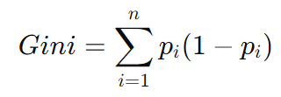
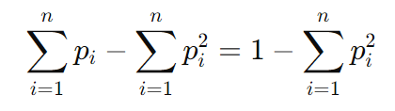
Gini Index
The Gini Index, also known as Gini Impurity, is a measure used in decision tree algorithms (like CART – Classification and Regression Trees) to determine the best attribute for splitting data.
It is calculated especially in terms of class probabilities as:
Which is equivalent to
Where, n is the number of classes, and p_{i}​ is the probability of an instance belonging to class i.

Slide 37
Key Properties of Gini Index
A lower Gini Index indicates a purer node (better classification), while a higher Gini Index means more impurity (mixed classes).
Range:
The Gini Index ranges from 0 to 1.
Gini=0 → Pure node (all instances belong to one class).
Gini=1 → Maximum impurity (instances are evenly distributed among all classes).
The attribute with the lowest Gini Index is chosen for the split, as it results in purer child nodes.

Slide 38
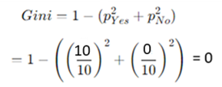
Gini Index
For a binary classification problem, the Gini Index ranges from 0 to 0.5, where:
0 occurs when all samples belong to one class.
0.5 occurs when classes are perfectly split (e.g., 50% in each class).
Example: Consider a dataset with 2 classes: Yes and No
Let, there are 10 instances with all 10 of class “Yes” and no instance of class “No”.
Then,

Slide 39
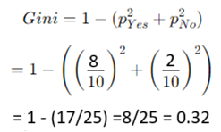
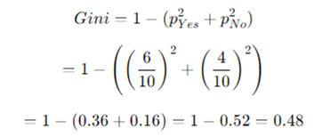
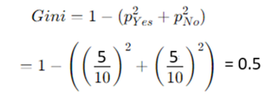
Gini Index
Let, there are 10 instances with 8
of class “Yes” and 2 of class “No”.
Then,
Let, there are 10 instances with
6 of class “Yes” and 4 of class “No”.
Then,
Let, there are 10 instances with 5
of class “Yes” and 5 of class “No”.
Then,

Slide 40
Gini Index
For multi-class classification, the Gini Index can be closer to 1, depending on the number of classes and their distribution.
The Gini Index is exactly 1 when the classes are infinitely and equally distributed
That means that every possible class has an equal probability and there are infinitely many classes.
However, in practical scenarios with a finite number of classes, the maximum Gini Index approaches but does not reach 1.

Slide 41

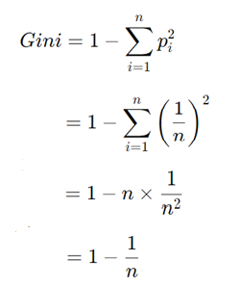
Gini Index
For example, let's assume an infinitely large number of classes, each with an equal probability:
Then, the Gini Index formula:
As n→∞, we get: Gini→1

Slide 42
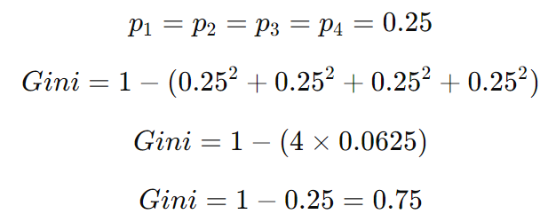
Gini Index
Real-World Example (Approaching 1 but Not Exactly)
For a finite number of classes, the highest possible Gini Index occurs when there are many classes with equal probabilities, but it never reaches exactly 1.
For example, if we have 4 classes with equal probabilities:
Thus, the Gini Index never actually reaches 1 in a practical scenario but gets closer as the number of equally probable classes increases.

Slide 43
Gini Index
If a data set D contains examples from n classes, gini index, gini(D) is defined as
where p_{j} is the relative frequency of class j in D
If a data set D is split on A into two subsets D₁ and D₂, the gini index gini(D) is defined as
Reduction in Impurity:
The attribute provides the largest reduction in impurity is chosen to split the node.

Slide 44
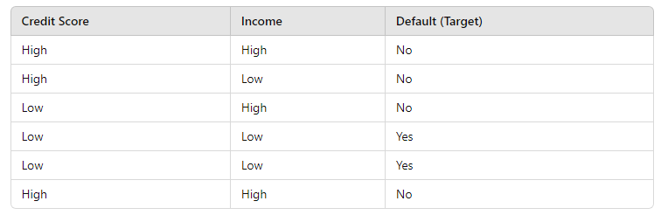
Constructing CART (a Decision Tree) Using Gini Index
Consider a dataset of loan applicants, where we want to predict if a person will default on a loan (Yes or No) based on two attributes: Credit Score (High/Low) and Income (High/Low).

Slide 45
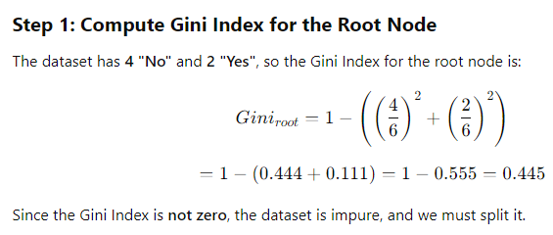
CART

Slide 46
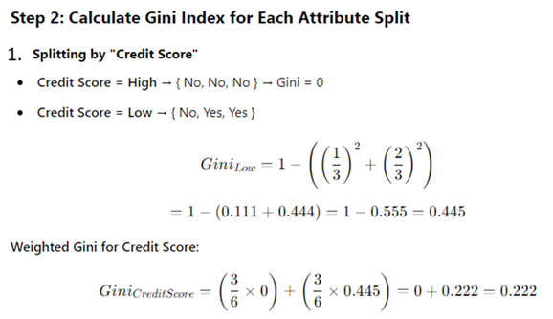
CART

Slide 47
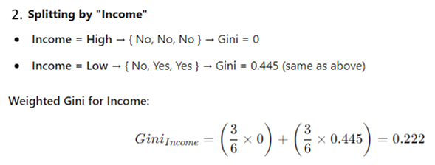
CART
Step 3: Select the Best Attribute for Splitting
- Gini(Credit Score) = 0.222 and Gini(Income) = 0.222
- Reduction in Impurity (Credit Score) = 0.445 – 0.222 = 0.223
- Reduction in Impurity (Income) = 0.445 – 0.222 = 0.223
Since both attributes have the same Gini Index, so reduction in impurities are same => we can choose any one, say Credit Score for the first spliting arbitrarily.

Slide 48
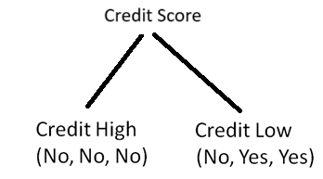
CART
Step 4: Create the First Split in the Decision Tree
Left Node (High Credit Score) is pure (Gini = 0), so it becomes a leaf node labeled "No".
Right Node (Low Credit Score) is still impure (Gini = 0.445), so we split it further.

Slide 49
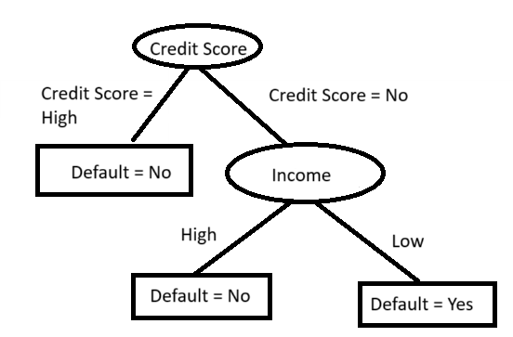
CART
Step 5: Further Splitting on "Income" (For Low Credit Score Branch)
Income = High → { No } → Gini = 0 (Pure)
Income = Low → { Yes, Yes } → Gini = 0 (Pure)
Final Decision Tree

Slide 50
Which One to Use?
If computational efficiency is a priority → Use Gini Index (CART).
If you want a more theoretically sound measure that accounts for information gain → Use Entropy (ID3, C4.5).
Both perform similarly in practice, but Gini is preferred when speed is a concern.

Slide 51
Information Gain VS Gini Index
1. Information Gain
Based on the concept of Entropy from Claude Shannon.
Measures how much uncertainty is reduced after splitting the dataset.
Used mainly in algorithms like ID3 and C4.5.
The attribute with the highest information gain is selected for the split.
Idea: More reduction in entropy → Better split.

Slide 52
Information Gain VS Gini Index
2. Gini Index
Measures impurity of a dataset.
Used mainly in the CART algorithm.
The attribute with the lowest Gini index is chosen for splitting.
Idea: Lower impurity → Better split.

Slide 53
Information Gain VS Gini Index
Information Gain: measures reduction in randomness.
Gini Index: measures how mixed the classes are.
The difference between uncertainty and impurity is subtle but important. Both describe how mixed or unpredictable the class labels are, but they come from different theoretical perspectives.

Slide 54
Information Gain VS Gini Index
1. Uncertainty (Entropy / Information Gain)
Comes from Entropy in Information Theory.
Measures how uncertain we are about predicting the class label.
If all samples belong to one class → uncertainty = 0.
If classes are evenly mixed → uncertainty is maximum.
Example:
Dataset: 50% Yes, 50% No
We are very uncertain about predicting the class.

Slide 55
Information Gain VS Gini Index
2. Impurity (Gini Index)
Measures how mixed the classes are within a node.
It represents the probability of misclassifying a randomly chosen sample.
Example:
Dataset: 50% Yes, 50% No
High impurity because samples belong to different classes.

Slide 56
Information Gain VS Gini Index
Uncertainty: “How unsure am I about the class label?”
Impurity: “How mixed are the classes in this node?”
In practice, both measure how good a split is in a decision tree, and they usually produce very similar results.
In a decision tree, a node is a point where the data is evaluated or split based on a feature (attribute).

Slide 57
Information Gain VS Gini Index
Each node contains a subset of the dataset.
Measures like Information Gain and Gini Index are used to decide how to split a node into child nodes.
A node is a point in the decision tree where data is stored and a decision or split is made.

Slide 58
Gini Index vs. Entropy
Feature | Entropy | Gini Index
Formula | Entropy=−∑p_{i}log₂p_{i} | Gini=1−∑p_{i}²
Range | 0 to log₂(n) (Binary case: 0 to 1) | 0 to 1 (Binary case: 0 to 0.5)
Meaning | Measure of information gain (uncertainty) | Probability of incorrect classification
Impurity Interpretation | Lower Entropy means less randomness | Lower Gini means purer node
Computation | Slower (logarithm calculations) | Faster (no logarithm)
Decision Tree Algorithm | Used in ID3, C4.5, and C5.0 | Used in CART (Classification and Regression Trees)
Splitting Preference | More sensitive to class distribution | Prefers larger class proportions (biased toward majority class)

Slide 59
Entropy is more sensitive to class distribution than Gini
Entropy reacts more strongly to changes in class probabilities than Gini Index does.
In other words, Entropy values change more significantly when class probabilities become more imbalanced, while Gini changes more gradually.

Slide 60


Entropy is more sensitive to class distribution than Gini
Example: Two-Class Classification (Binary Case)
Suppose we have a node in a decision tree with two classes: Class A and Class B. The probabilities of these classes are p and 1−p.
Then,
and
Now, let’s see how these values change for different probabilities:
p (Probability of class A) | Entropy | Gini Index
0.5 | 1.00 | 0.50
0.7 | 0.88 | 0.42
0.9 | 0.47 | 0.18
0.99 | 0.08 | 0.02

Slide 61
What does it Mean?
Entropy decreases more sharply as one class becomes dominant.
At p=0.9, Entropy drops to 0.47, while Gini is still 0.18.
At p=0.99, Entropy is almost 0.08, whereas Gini is 0.02.
Gini Index decreases more gradually as class imbalance increases.
Thus, Entropy is more sensitive because it penalizes uncertainty more heavily.
If the class distribution is highly imbalanced, Entropy drops significantly, while Gini decreases more smoothly.
So, for highly imbalanced datasets, Gini Index is generally a better choice than Entropy.

Slide 62
For Highly Imbalanced Datasets
Entropy penalizes impurity more aggressively, which can lead to deeper trees with more splits to separate the minority class completely.
Issue with Entropy in Imbalanced Datasets:
- Since Entropy reacts more strongly to class imbalance, it may create a very deep tree to minimize uncertainty.
- This can lead to overfitting, where the tree models noise instead of patterns.

Slide 63
For Highly Imbalanced Datasets
If your dataset is highly imbalanced: - Use Gini Index if you prioritize computational efficiency and want a balanced tree. - Use Entropy if you want to aggressively separate the minority class (but beware of overfitting).
Alternative Approaches to Handle Imbalance: Regardless of Gini or Entropy, you should also consider:
- Balancing the dataset (e.g., SMOTE, oversampling, undersampling).
- Cost-sensitive learning (assigning higher weights to the minority class).
- Ensemble of decision trees
Pruning the decision tree to prevent overfitting.

Slide 64
What is Overfitting in Decision Trees?
Overfitting occurs when a decision tree model learns not only the underlying pattern in the training data but also irrelevant details or noise, making it too complex and highly specific to the training dataset.
As a result, the model performs exceptionally well on training data but generalizes poorly to unseen test data, i.e., Poor accuracy for unseen samples.

Slide 65
Causes of Overfitting in Decision Trees
Excessive Depth (Too Many Splits)
Decision trees tend to grow deep when they attempt to capture every minor variation in the training data, leading to an overly complex structure.
Small Leaf Nodes (Few Samples Per Leaf)
If each leaf node contains very few training samples, the model memorizes the training data instead of learning a generalizable rule.
High Variance in the Data (Noisy Features)
Decision trees are sensitive to noise, and they may split excessively based on noisy or irrelevant features rather than meaningful patterns.

Slide 66
Causes of Overfitting in Decision Trees
Imbalanced Datasets
If certain classes dominate the dataset, the decision tree may focus too much on those and fail to generalize well for underrepresented classes.
Lack of Feature Selection
Using all available features without evaluating their importance can lead to redundant or irrelevant splits, making the tree unnecessarily complex.

Slide 67
Methods to Prevent Overfitting in Decision Trees
1. Pruning (Post-Pruning and Pre-Pruning)
Pruning is a technique used to reduce the complexity of a decision tree by removing unnecessary branches that do not contribute significantly to decision-making.
Pre-Pruning (Early Stopping)
Stop the tree from growing too deep by limiting its complexity during training.
Techniques:
Max Depth: Set a limit on how deep the tree can grow.
Min Samples per Leaf: Specify the minimum number of samples required in a leaf node.
Min Samples per Split: Ensure a minimum number of samples required to split a node.

Slide 68
Methods to Prevent Overfitting in Decision Trees
Post-Pruning (Cost Complexity Pruning or Reduced Error Pruning)
Grow the full tree first and then remove branches that do not improve test accuracy.
Techniques:
Use cross-validation to decide which branches to prune.
Set a pruning parameter α (alpha) in Cost Complexity Pruning (CCP) to penalize tree complexity.

Slide 69

What is Cost Complexity Pruning (CCP)?
In decision trees, we don’t just want accuracy—we also want simplicity (to avoid overfitting).
CCP balances both using this formula:
R(T) → Error of the tree (how wrong it is)
∣T∣ → Number of leaf nodes (tree size / complexity)
α→ Penalty for complexity

Slide 70
What is Cost Complexity Pruning (CCP)?
What does α (alpha) actually do?
Think of α as a “simplicity preference knob”:
When α = 0
- No penalty for complexity
- Tree grows as large as possible
- Likely overfitting

Slide 71
What is Cost Complexity Pruning (CCP)?
When α is small (e.g., 0.001)
- Slight penalty
- Keeps most splits
- Mild pruning
When α is large
- Heavy penalty on tree size
- Many branches removed
- Simpler tree → may underfit

Slide 72
Underfitting
Underfitting = model is too simple and fails to learn the data.
Underfitting happens when a model is too simple to capture the real patterns in the data.
It’s like trying to fit a straight line to data that clearly curves.
The model misses important relationships, so it performs poorly.
Key characteristics
- High error on training data
- High error on test data
- Model is too simple

Slide 73
Underfitting
In decision trees Underfitting can happen if:
- Tree is too shallow (low depth)
- High min_samples_split
- High min_samples_leaf
- High pruning parameter (α)
The tree becomes too small to capture patterns.
Fixing underfitting: Increase model complexity
For trees:
Increase depth
Reduce pruning (lower α)
Lower min_samples_leaf / min_samples_split

Slide 74
Parameters vs Hyperparameters in a Decision Tree
1. Parameters (learned from data)
These are automatically learned by the model during training.
In a decision tree, parameters include:
- Split rule LIKE feature A ≤ 5.3
- Feature chosen at each node
- Threshold values
- Tree structure (which nodes split, how deep it goes)
- Leaf predictions (class labels or values)
You do NOT set these manually—the algorithm figures them out.

Slide 75
Parameters vs Hyperparameters in a Decision Tree
2. Hyperparameters (set before training)
These are controls you set to guide how the tree is built.
Common Decision Tree Hyperparameters
- Tree size & shape
- max_depth → Maximum depth of the tree
- min_samples_split → Minimum samples required to split a node
- min_samples_leaf → Minimum samples required in a leaf
- max_leaf_nodes → Maximum number of leaf nodes
- Pruning / Regularization: ccp_alpha (α) → Controls pruning strength (higher = simpler tree)

Slide 76
Methods to Prevent Overfitting in Decision Trees
2. Using Ensemble Methods
Instead of relying on a single decision tree, ensemble methods build multiple trees and combine their results for better generalization.
Random Forest
Constructs multiple decision trees and averages their predictions, reducing variance.
Uses feature randomness to prevent overfitting.
Gradient Boosting Trees (XGBoost, LightGBM, CatBoost)
Boosting algorithms build multiple trees sequentially, each correcting errors of the previous tree.
Regularization methods help prevent overfitting.

Slide 77
Methods to Prevent Overfitting in Decision Trees
3. Feature Selection and Engineering
Remove irrelevant or redundant features to simplify the tree.
Use correlation analysis to identify and remove highly correlated features.
4. Regularization (Hyperparameter Tuning)
Max Depth – Limits the depth of the tree.
Min Samples per Split – Ensures a minimum number of samples are required to split a node.
Min Samples per Leaf – Prevents the tree from creating too many small leaf nodes.
Max Features – Limits the number of features considered for each split.
5. Cross-Validation for Hyperparameter Tuning
Use k-fold cross-validation to evaluate model performance on different data splits and prevent overfitting.

Slide 78
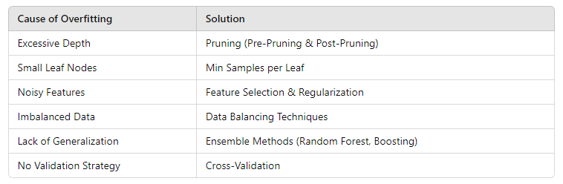
Summary
By implementing pruning, regularization, feature selection, and ensemble learning techniques, we can effectively reduce overfitting in decision trees, ensuring better generalization to unseen data.

Slide 79
Other Attribute Selection Measures
CHAID: a popular decision tree algorithm, measure based on χ² test for independence
C-SEP: performs better than info. gain and gini index in certain cases
G-statistic: has a close approximation to χ² distribution
MDL (Minimal Description Length) principle (i.e., the simplest solution is preferred):
The best tree as the one that requires the fewest # of bits to both (1) encode the tree, and (2) encode the exceptions to the tree
Multivariate splits (partition based on multiple variable combinations)
CART: finds multivariate splits based on a linear comb. of attrs.
Which attribute selection measure is the best?
Most give good results, none is significantly superior than others

Slide 80
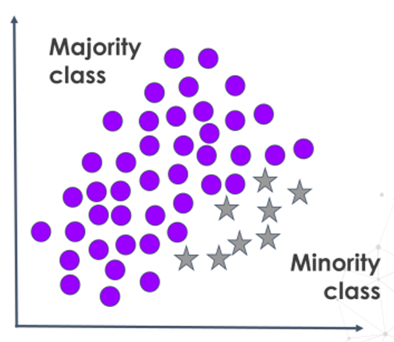
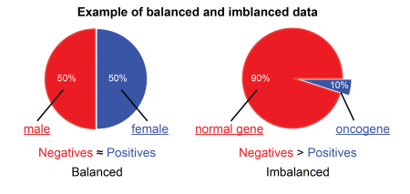
Introduction
Class imbalance is a common problem in machine learning, especially in classification tasks, where the number of examples in one class is significantly higher or lower than in the other classes.
A class imbalanced dataset is one in which the distribution of classes is not uniform. The dataset may contain one or more than one Minority class where the number of samples is significantly less than the Majority class.
Johnson, J. M., & Khoshgoftaar, T. M. (2019). Survey on deep learning with class imbalance. Journal of Big Data, 6(1), 1-54.

Slide 81
Introduction
Class imbalance is present in almost all real life data
Detection of Disease (Usually less number of data present in disease class)
Credit card fraud detection (Few number of fraudulent transactions)
Hardware fault detection (Usually number of fault is less)
Sentiment Detection (Data of particular sentiment can be less)
Traffic Accident prediction (Number of accident cases are less)

Slide 82
Challenges in Imbalanced Dataset
Bias towards majority class: Most models aim to achieve maximize the overall accuracy, so they tend to favor the majority class, resulting in poor performance on the minority class.
Underrepresentation of the Minority Class: Critical features of the minority class may not be learned well due to insufficient samples.
Poor Metrics for Evaluation: Accuracy alone is misleading. Precision, recall, F1-score, and other metrics are more informative in these scenarios.

Slide 83
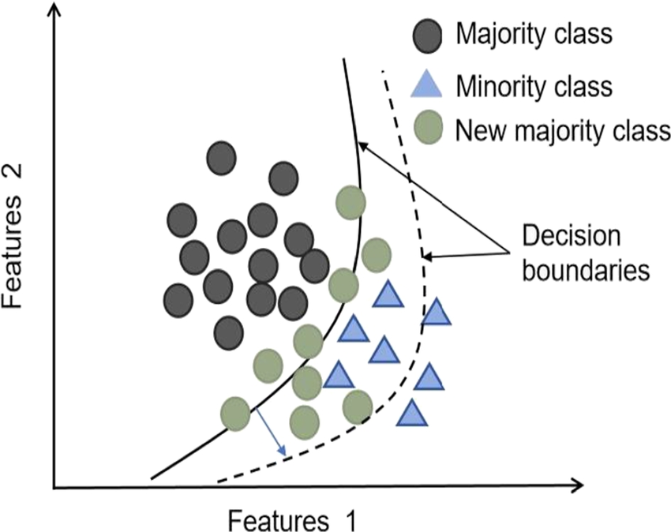
Challenges in Imbalanced Dataset
(iv) Poor Decision Boundaries: In imbalanced datasets, decision boundaries can be poorly defined, as the model learns to optimize for accuracy on the majority class, ignoring the correct classification of the minority class.
When the new majority samples are added arbitrarily, they affect the decision boundaries

Slide 84
Challenges in Imbalanced Dataset
The decision boundaries learned on majority samples tend to be increasingly biased towards the majority class, leading to the neglect of minority class data samples.
This results:
- in model overfitting for majority class samples
- often leading to low generalization to minority class samples.

Slide 85
Challenges in Imbalanced Dataset
Over time, the model may treat minority class patterns as noise, and misclassifying them because it has learned to prioritize the majority class patterns.
(vi) Over-reliance on Majority Samples in Loss Function: If the loss function does not take imbalance into account, it becomes heavily influenced by the majority class samples, reinforcing their patterns and resulting in overfitting.
https://www.researchgate.net/figure

Slide 86
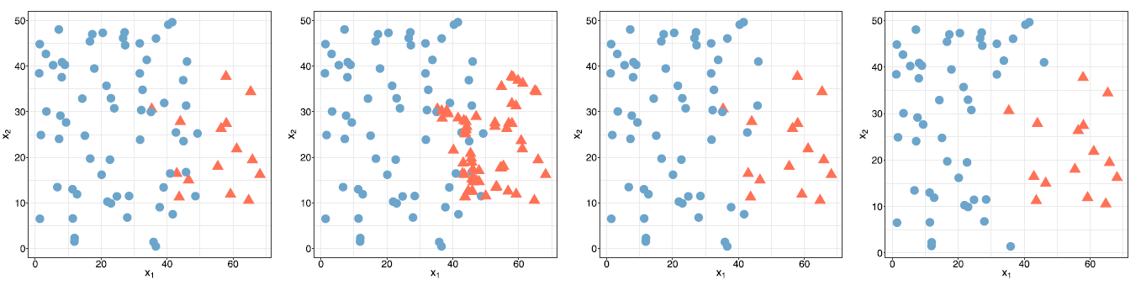
Class Overlapping
Handling class imbalance is more difficult in presence of class overlapping.
Overlapping has more effect on classifier performance than imbalance.
(a) (b) (c) (d)

Slide 87
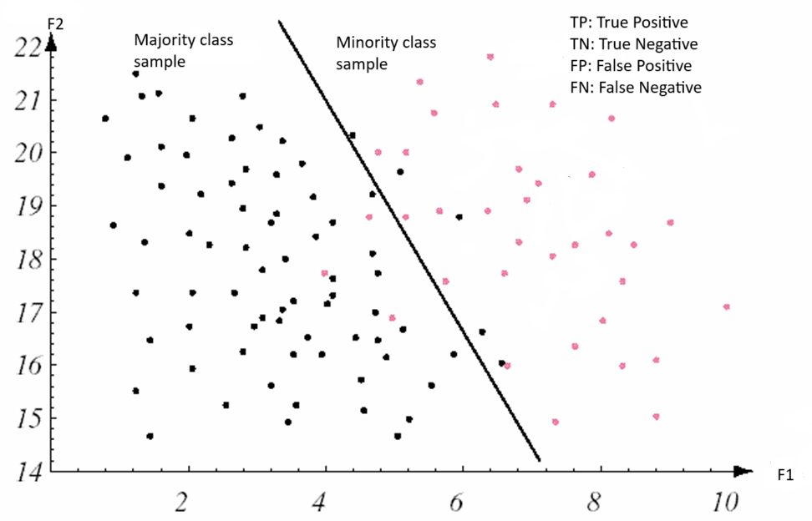
Classifier Evaluation

Slide 88


Classifier Evaluation Metrics: Confusion Matrix
Precision: exactness – what % of tuples that the classifier labeled as positive are actually positive?
Recall: completeness – what % of positive tuples did the classifier label as positive?
Perfect score of Precision and Recall is 1.0

Slide 89


Classifier Evaluation Metrics: Confusion Matrix
Classifier Accuracy, or recognition rate: percentage of test set tuples that are correctly classified
F-Measure (F₁ - Score): harmonic mean of precision and recall.

Slide 90
Importance of Recall
Let, a dataset contains 90 negative (majority) samples and 10 positive (minority) samples.
Let a classifier gives TP=2, FN=8, FP=0, TN=90
Here, Accuracy=92%, Precision = 100%, Recall=20%
In a disease dataset, Recall is crucial because it's important to minimize false negatives, ensuring that most (if not all) actual cases are identified.
Missing a disease case (false negative) could have severe consequences for patient health.

Slide 91
Importance of Precision
Let, a dataset contains 10 positive (minority) samples and 90 negative (majority) samples.
Let a classifier gives TP=10, FN=0, FP=50, TN=40
Here, Accuracy=50%, Precision = 1/6=17%, Recall=100%
Precision is very important in fraud detection.
In this scenario, misclassifying an innocent transaction (negative sample) as fraudulent (false positive) can inconvenience customers and damage trust.
High precision in fraud detection ensures that only truly fraudulent transactions are identified, minimizing unnecessary intervention.

Slide 92


Classifier Evaluation Metrics: Sensitivity and Specificity
Sensitivity: True Positive recognition rate =
= Recall
Specificity: True Negative recognition rate =
Actual Class \ Predicted class | cancer = yes | cancer = no | Total | Recognition(%)
cancer = yes | 90 | 210 | 300 | Sensitivity = 30.00
cancer = no | 140 | 9560 | 9700 | Specificity = 98.56
Total | 230 | 9770 | 10000 | Accuracy=96.40
Precision=90/230 = 39.13, Recall=90/300=30.00, F-Score=33.96
92

Slide 93
Mitigation Strategies
Class Weights: Adjust the loss function by assigning higher weights to minority class samples, making errors on minority samples more significant.
Resampling: Use techniques like oversampling the minority class or undersampling the majority class to balance the dataset.
Use Advanced Models: Ensemble methods, such as random forests or gradient boosting, can help by creating multiple classifiers that may handle the imbalance better.
By applying these techniques, the model can achieve better generalization across classes and reduce the risk of overfitting to the majority class in imbalanced datasets.

Slide 94
Taxonomy of Existing Solutions for Class Imbalance
Class Imbalance
Data Level
Undersampling
Oversampling
Algorithm Level
Ensemble
Hybrid
Augmentation
Prati, R. C., Batista, G. E., & Monard, M. C. (2004). Class imbalances versus class overlapping: an analysis of a learning system behavior. In MICAI 2004

Slide 95
Data Level Methods for Class Imbalance
Undersampling | Oversampling | Hybrid
Random Undersampling Condensed Nearest Neighbor Tomek Links One Sided Selection Neighborhood Cleaning Rule Undersampling Based on Clustering | Random Oversampling SMOTE Borderline-SMOTE Safe Level SMOTE ADASYN CLUSBUS | SMOTE-ENN SMOTE-Tomek SPIDER
García, V., Sánchez, J. S., Marqués, A. I., Florencia, R., & Rivera, G. (2020). Understanding the apparent superiority of over-sampling through an analysis of local information for class-imbalanced data. Expert Systems with Applications, 158, 113026.

Slide 96
Undersampling: Tomek links
Tomek Links are a technique used in imbalanced classification problems to remove borderline or noisy instances, helping improve classifier performance.
They were introduced by Ivan Tomek in 1976 as a method for data cleaning.
A Tomek Link exists between two instances (𝑥₁, 𝑥₂) from different classes if:𝑥₁ is the nearest neighbor of 𝑥₂, and 𝑥₂ is the nearest neighbor of 𝑥₁.

Slide 97
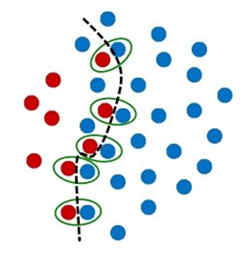
Undersampling: Tomek link
Tomek links are used to:
(i) Identify and remove overlapping instances: By eliminating majority class instance in each Tomek link, one can reduce the overlap between classes, leading to better-defined class boundaries.
(ii) Clean the dataset: The idea is that such pairs lie close to the decision boundary and might represent noise or borderline cases. Removing Tomek links helps in getting rid of noisy instances that may adversely affect the classifier's performance.

Slide 98
Undersampling: Based on Clustering
Sampling: obtaining a small sample s to represent the whole data set N
Cluster the majority samples into different groups
Stratified sampling: Approximate the percentage of each group in the overall dataset so that the distribution in each group is approximately the same as that in the initial set
Cluster the majority samples
Apply the stratify sampling

Slide 99
Oversampling: SMOTE
SMOTE (Synthetic Minority Over-sampling Technique) is a popular method used in machine learning to address the problem of imbalanced datasets.
Selecting Minority Class Samples: For each minority sample, it finds its k-nearest neighbors in the minority class.
It picks one of the neighbors randomly and creates a synthetic sample along the line segment between the minority sample and its chosen neighbor.
The synthetic sample is generated as a weighted combination of the two points:
new_{sample} = sample + random(0, 1) ×(neighbor – sample)

Slide 100
Key Points in SMOTE
Synthetic Sampling: Unlike simple oversampling, SMOTE doesn't just duplicate samples. Instead, it creates new, synthetic samples that are similar but not identical to existing ones.
Better Generalization: SMOTE often leads to better model generalization because the model gets a more balanced view of the minority class.
Use with Caution: SMOTE may sometimes introduce noise, especially if the minority class samples are spread across a wide feature space or overlap significantly with the majority class.

Slide 101
Oversampling : Borderline-SMOTE
Borderline-SMOTE: It is a variation of SMOTE designed to focus on samples near the decision boundary rather than generating synthetic data randomly across the minority class.
This improves model performance by strengthening the decision boundary.

Slide 102
Borderline-SMOTE
1. Identify Borderline Instances
For each minority-class instance, find its k-nearest neighbors.
Count how many of these neighbors belong to the majority class.
If most of the k-nearest neighbors are from the majority class, the minority instance is considered borderline instances which are "hard to classify" (i.e., close to the decision boundary).
These borderline instances are selected for oversampling.

Slide 103
Borderline-SMOTE
2. Generate Synthetic Samples
Similar to SMOTE, synthetic points are created only for borderline instances.
A new sample is generated along the line segment between the borderline instance and one of its k minority-class neighbors: X_{new}=X_{original}+ λ×(X_{neighbor}−X_{original}), where λ is a random number between 0 and 1.

Slide 104
Borderline-SMOTE
There are two Types of Borderline-SMOTE
(i) Borderline-SMOTE1: Only oversamples the identified borderline minority instances.
(ii) Borderline-SMOTE2: Generates more synthetic points between the minority instances and majority-class neighbors, further strengthening the decision boundary.

Slide 105
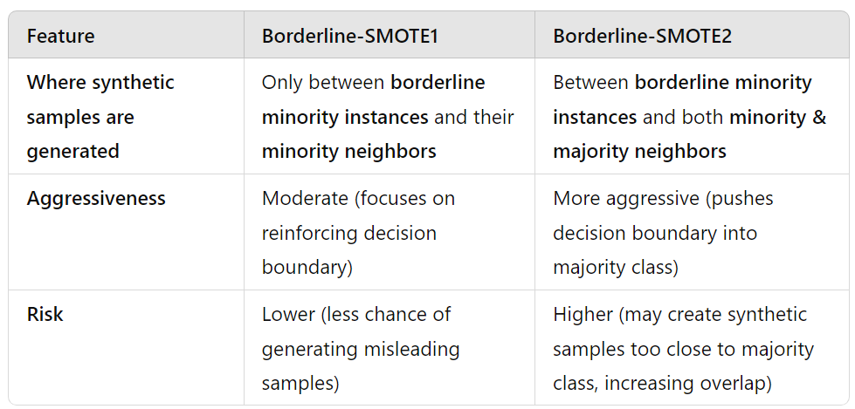
Differences between Borderline-SMOTE1 vs. Borderline-SMOTE2

Slide 106
Hybrid Sampling
1. SMOTE-Tomek
Tomek links are often used in combination with other techniques to address class imbalance.
For instance, the SMOTE-Tomek Links method first applies the Synthetic Minority Over-sampling Technique (SMOTE) to generate synthetic samples for the minority class and
Then uses Tomek links to clean the resulting dataset by removing overlapping instances.

Slide 107
Hybrid Sampling
2. SMOTE-ENN:
SMOTE-ENN (Synthetic Minority Over-sampling Technique + Edited Nearest Neighbors) is a hybrid sampling technique.
It first oversamples the minority class using SMOTE and then cleans the dataset using Edited Nearest Neighbors (ENN).
This combination helps improve class balance while removing noisy and borderline instances, leading to better classification performance.

Slide 108
How SMOTE-ENN Works
Step 1: Apply SMOTE (Oversampling)
SMOTE creates synthetic minority class samples by interpolating between existing minority instances.
This helps balance the dataset by increasing the number of minority samples.
Step 2: Apply ENN (Undersampling)
ENN removes samples (both majority and minority class instances) that are misclassified by their k-nearest neighbors (k-NN, usually k=3).

Slide 109
Advantages of SMOTE-ENN
Better class balance – Increases minority samples while also removing irrelevant majority samples.
Reduces noise – ENN removes misclassified or ambiguous points, improving data quality.
Stronger decision boundary – Helps classifiers perform better by removing confusing samples.

Slide 110
Deep Learning based Oversampling
Deep learning techniques can be useful for oversampling, particularly when dealing with complex, high-dimensional data where traditional oversampling methods (like SMOTE) might fall short.
Deep learning-based oversampling approaches are more sophisticated and can generate realistic synthetic samples, preserving the complexity of the minority class distribution.
The following deep learning techniques are applied in oversampling:
Generative Adversarial Networks (GANs)
Variational Autoencoders (VAEs)
Reinforcement Learning for Data Augmentation
Autoencoders with Clustering Techniques

Slide 111
Thank You

